Slide 1
Chapter 8
Correlation

Slide 2
Measuring Relationships
We need to see whether as one variable increases, the other increases, decreases or stays the same.
This can be done by calculating the Covariance.
  We look at how much each score deviates from the mean.
  If both variables deviate from the mean by the same amount, they are likely to be related.

Slide 3
Modeling Relationships
First, look at some scatterplots of the variables that have been measured.
Outcome_{i} = (model ) + error_{i}
Outcome_{i} = (bX_{i} ) + error_{i}

Slide 4
Some Data about Toffees and Adverts
Participant: | 1 | 2 | 3 | 4 | 5 | Mean | s
Adverts Watched | 5 | 4 | 4 | 6 | 8 | 5.4 | 1.673
Packets Bought | 8 | 9 | 10 | 13 | 15 | 11.0 | 2.915

Slide 5
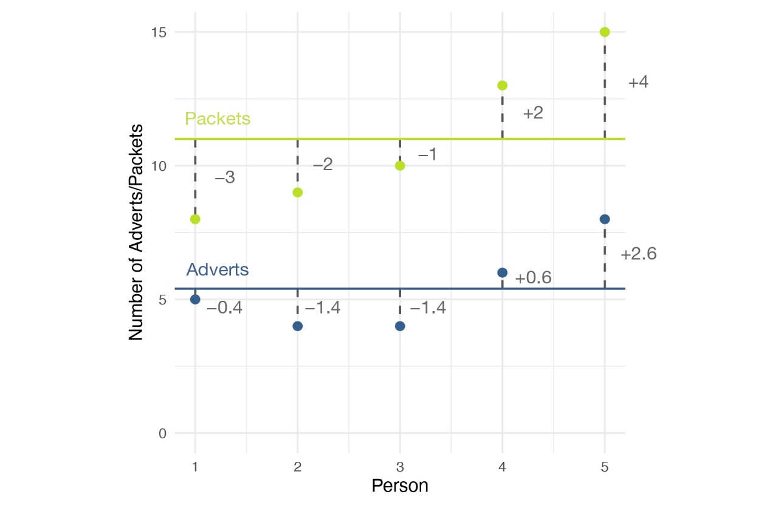
Graphical display of the differences between the observed data and the means of two variables

Slide 6
Revision of Variance (1 of 2)
The variance tells us by how much scores deviate from the mean for a single variable.
It is closely linked to the sum of squares.
Covariance is similar – it tells is by how much scores on two variables differ from their respective means.

Slide 7

Revision of Variance (2 of 2)
$$\begin{matrix}\text{variance}=\frac{\sum{{\left(x_{i}−\overline{x}\right)}^{2}}}{N−1} \\ \end{matrix}$$

Slide 8
Covariance (1 of 3)
Calculate the error between the mean and each subject’s score for the first variable (x).
Calculate the error between the mean and their score for the second variable (y).
Multiply these error values.
Add these values and you get the cross-product deviations.
The covariance is the average cross-product deviations

Slide 9
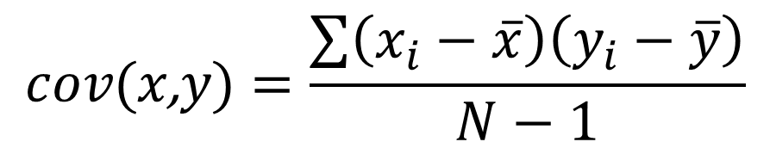
Covariance (2 of 3)
$$cov\text{(}x\text{,}y\text{)}=\frac{\sum{\left(x_{i}−\overline{x}\right)\left(y_{i}−\overline{y}\right)}}{N−1}$$

Slide 10
Graphical display of the differences between the observed data and the means of two variables

Slide 11
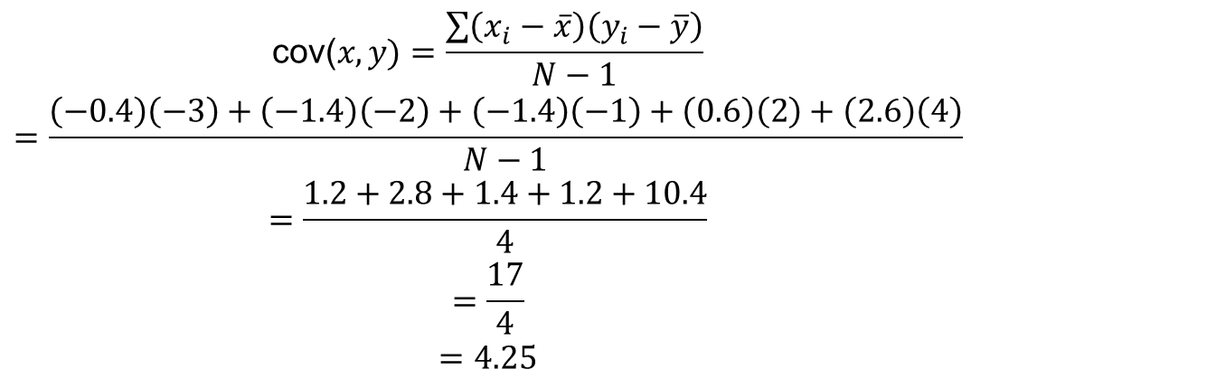
Covariance (3 of 3)
$$\begin{matrix}\text{cov}\text{(}x,y\text{)}=\frac{\sum{\left(x_{i}−\overline{x}\right)\left(y_{i}−\overline{y}\right)}}{N−1} \\ =\frac{\left(−0.4\right)\left(−3\right)+\left(−1.4\right)\left(−2\right)+\left(−1.4\right)\left(−1\right)+\left(0.6\right)\left(2\right)+\left(2.6\right)\left(4\right)}{N−1} \\ =\frac{1.2+2.8+1.4+1.2+10.4}{4} \\ =\frac{17}{4} \\ =4.25\end{matrix}$$

Slide 12
Problems with Covariance
It depends upon the units of measurement.
  E.g. the covariance of two variables measured in Miles might be 4.25, but if the same scores are converted to km, the covariance is 11.
One solution: standardize it!
  Divide by the standard deviations of both variables.
The standardized version of covariance is known as the correlation coefficient (Pearson's r).
  It is relatively affected by units of measurement.

Slide 13
What is a Correlation?
It is a way of measuring the extent to which two variables are related.
It measures the pattern of responses across variables.

Slide 14
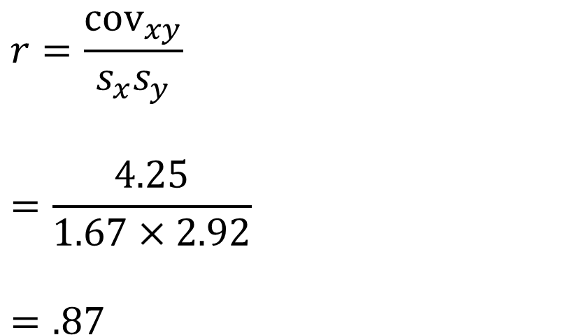
The Correlation Coefficient
$$r=\frac{cov_{xy}}{s_{x}s_{y}}$$
$$=\frac{4.25}{1.67×2.92}$$
$$=.87$$

Slide 15
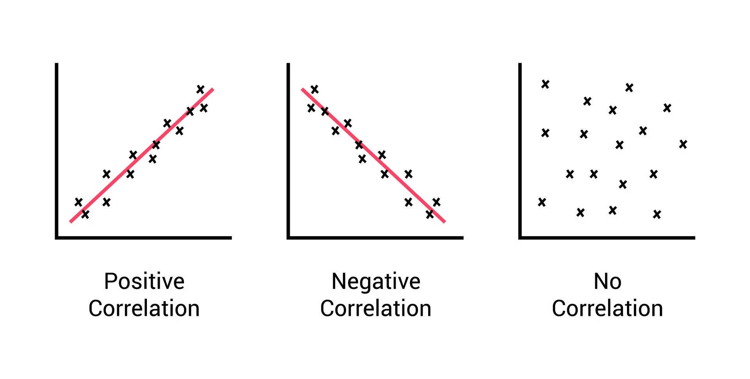
The Direction of the Relationship

Slide 16
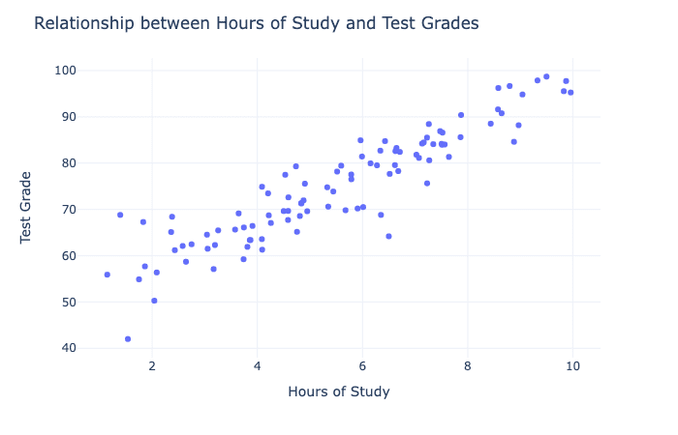
Correlational Research
Notes:
Why use correlations?

Slide 17
Things to Know about the Correlation
It varies between -1 and +1
  0 = no relationship
It is an effect size
  ±.1 = small effect
  ±.3 = medium effect
  ±.5 = large effect
Coefficient of determination, r²
  By squaring the value of r you get the proportion of variance in one variable shared by the other.

Slide 18
Correlation and Causality
The third-variable problem:
  In any correlation, causality between two variables cannot be assumed because there may be other measured or unmeasured variables affecting the results.
Direction of causality:
  Correlation coefficients say nothing about which variable causes the other to change.

Slide 19
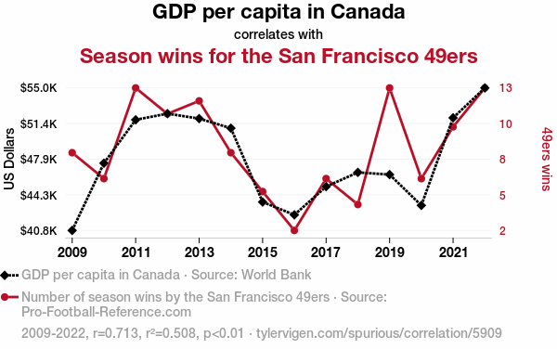
Spurious Correlations (1)

Slide 20
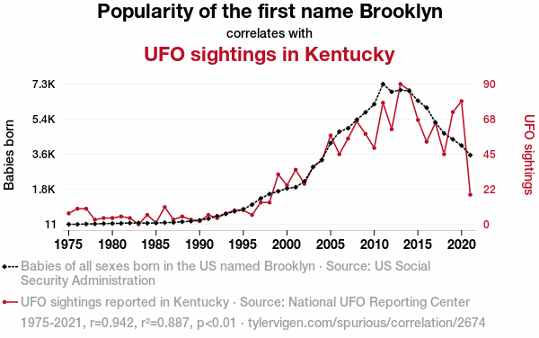
Spurious Correlations (2)

